Slide 1
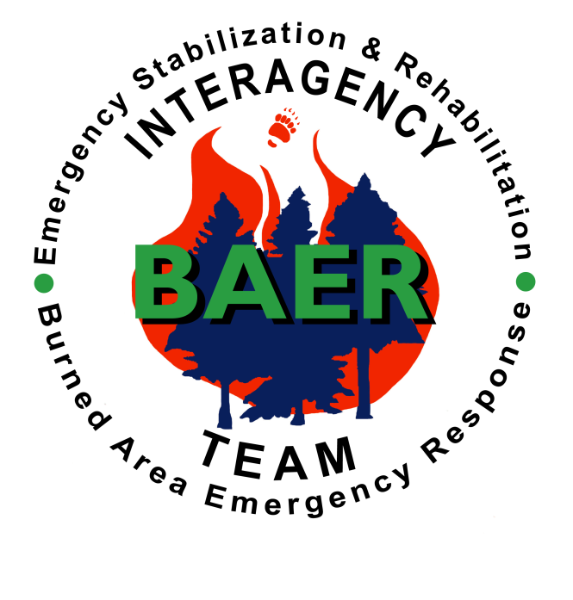
Burned Area Emergency Response Program
BAER

Slide 2

BAER PURPOSE
To identify imminent post-fire threats to life, safety, and property.
Critical natural and cultural resources resulting from the effects of a fire.
Take immediate actions to manage unacceptable risks.

Slide 3
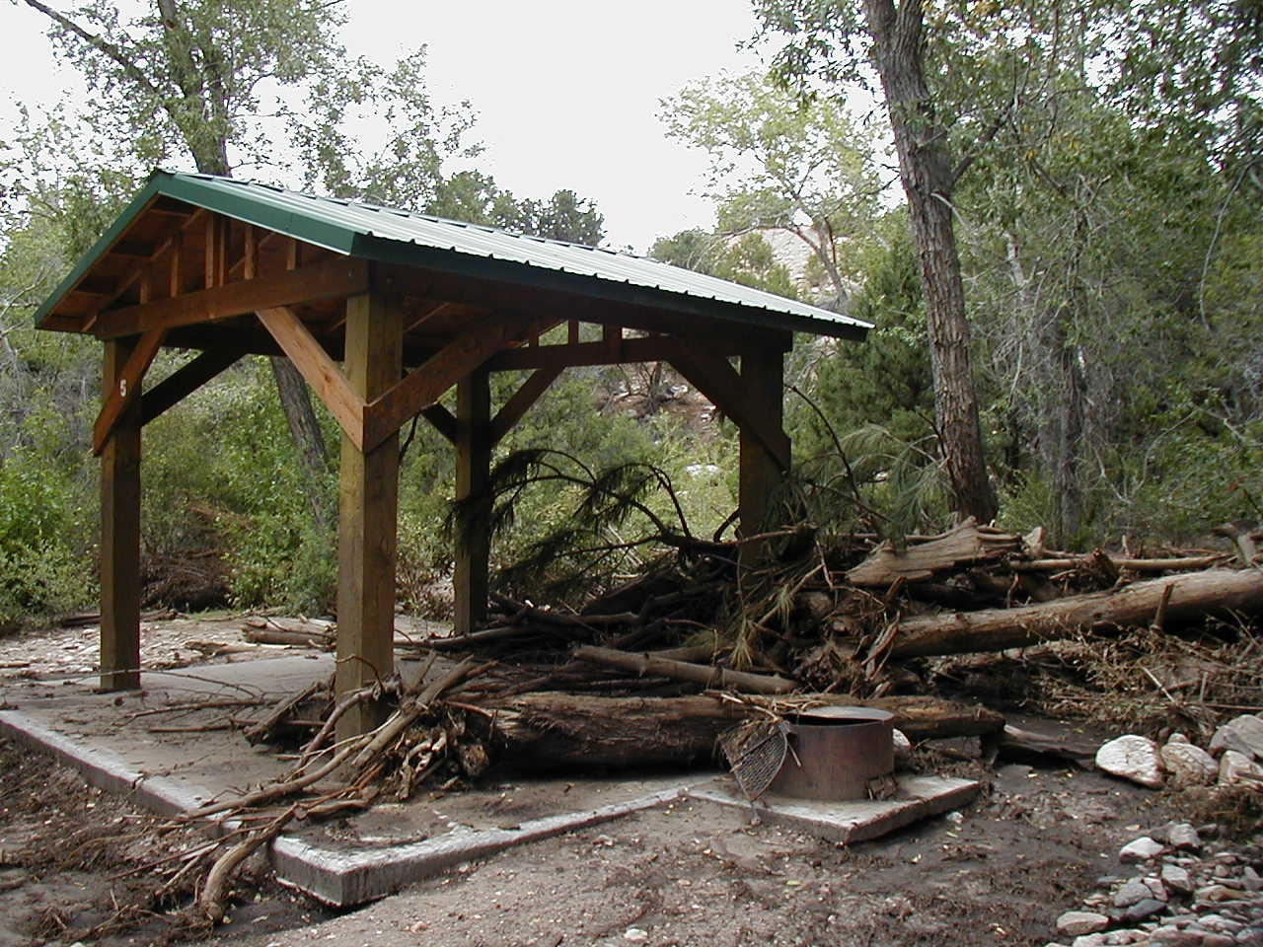
BAER
BAER is an emergency function and should be treated as such by the Incident Commander and Agency Administrator

Slide 4
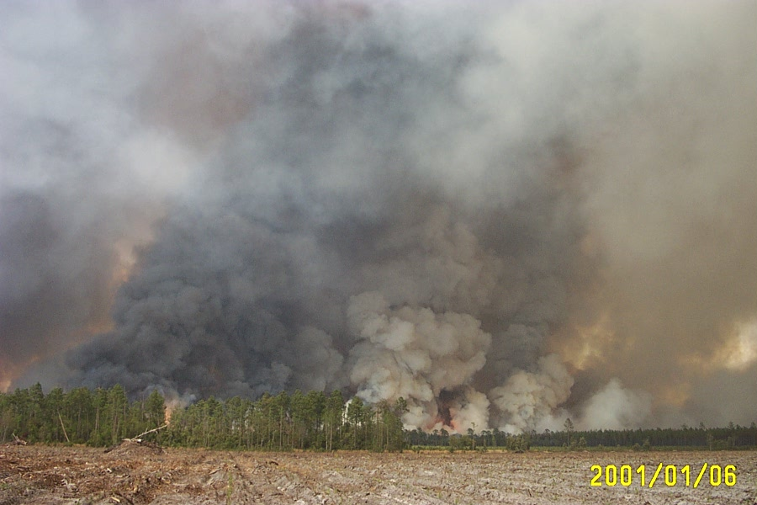
BAER and Wilderness Areas
- permitted to prevent unnatural loss of wilderness resource or
- to prevent protect life, property, and other resource values outside of wilderness

Slide 5
BAER Policies
Forest Service Manual 2500, Chapter 2523, Forest Service Handbook, Chapter 2509
DOI, Department Manual, Part 620: Wildland Fire Management, Chapter 3
Interagency Burned Area Emergency Stabilization and Rehabilitation Handbook

Slide 6
Rehabiliation Components
Suppression Rehabilitation
Emergency Stabilization
Rehabilitation
Restoration

Slide 7
PROGRAM COMPONENTS
 | Suppression Rehabilitation | Emergency Stabilization | Rehabilitation | Restoration
Objective: | Repair suppression damages | Protect life and property | Repair damages | Long Term Ecosystem Restoration
Damage due to: | Suppression activities | Post-fire events | Fire | Fire
Urgency: | Before incident closeout | 1-12 months | 1-3 years | 3 + years
Responsibility | Incident commander | Agency Administrator | Agency Administrator | Agency Administrator
Funding type: | Suppression (fire) | Emergency Stabilization | Rehabilitation | Regular program
Notes:
A final look at the reason, responsibility and funding for the different types of post-fire rehabilitation.

Slide 8
Emergency Stabilization
Emergency stabilization treatments limited to 1 yr post fire from containment – recent policy change limits NNIS treatments to this
ES plans must be submitted within 7 days from containment, negotiable based on intent and complexity
Invasive species emergency stabilization must be addressed in a pre-existing management plan

Slide 9
Rehabilitation
Rehabilitation treatments limited to 3 years post fire, must include monitoring
Rehab Plans should be completed within 7-10 days of containment, however could vary for each agency – contact BAER coordinator
Intended to repair or improve lands, natural, or cultural resources damaged directly by fire and unlikely to recover naturally

Slide 10
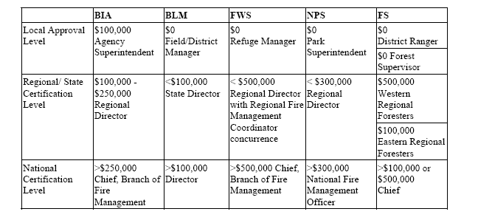
Required Approvals

Slide 11
FSM 2523.03
  Conduct assessments (FSM 2523.1) promptly on all burned areas following wildland fires to determine if emergency stabilization treatment is needed.
  An interdisciplinary process should be used when fires exceed 500 acres or when potential threats to life, property, natural resources, or cultural resources exist as a result of a smaller fire.

Slide 12
FSH 2509.13
Responsibility of Team Leader
  Determine if a survey team is needed by conducting a reconnaissance survey
  If the reconnaissance survey shows that emergency rehabilitation is not needed or justified, document this conclusion on Form FS-2500-8 (Burned-Area Report), and recommend to the Forest Supervisor that the burned-area survey not be conducted and that emergency rehabilitation of burned-area survey is unnecessary.

Slide 13
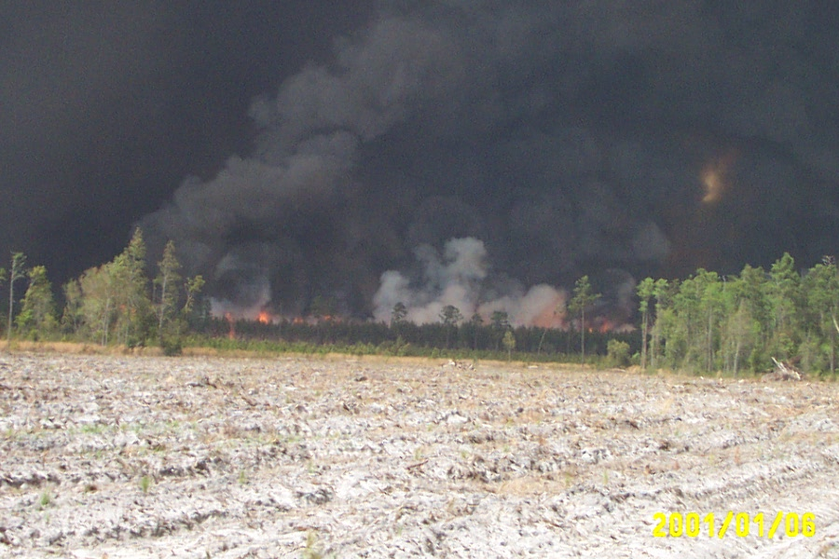
PHOTO

Slide 14
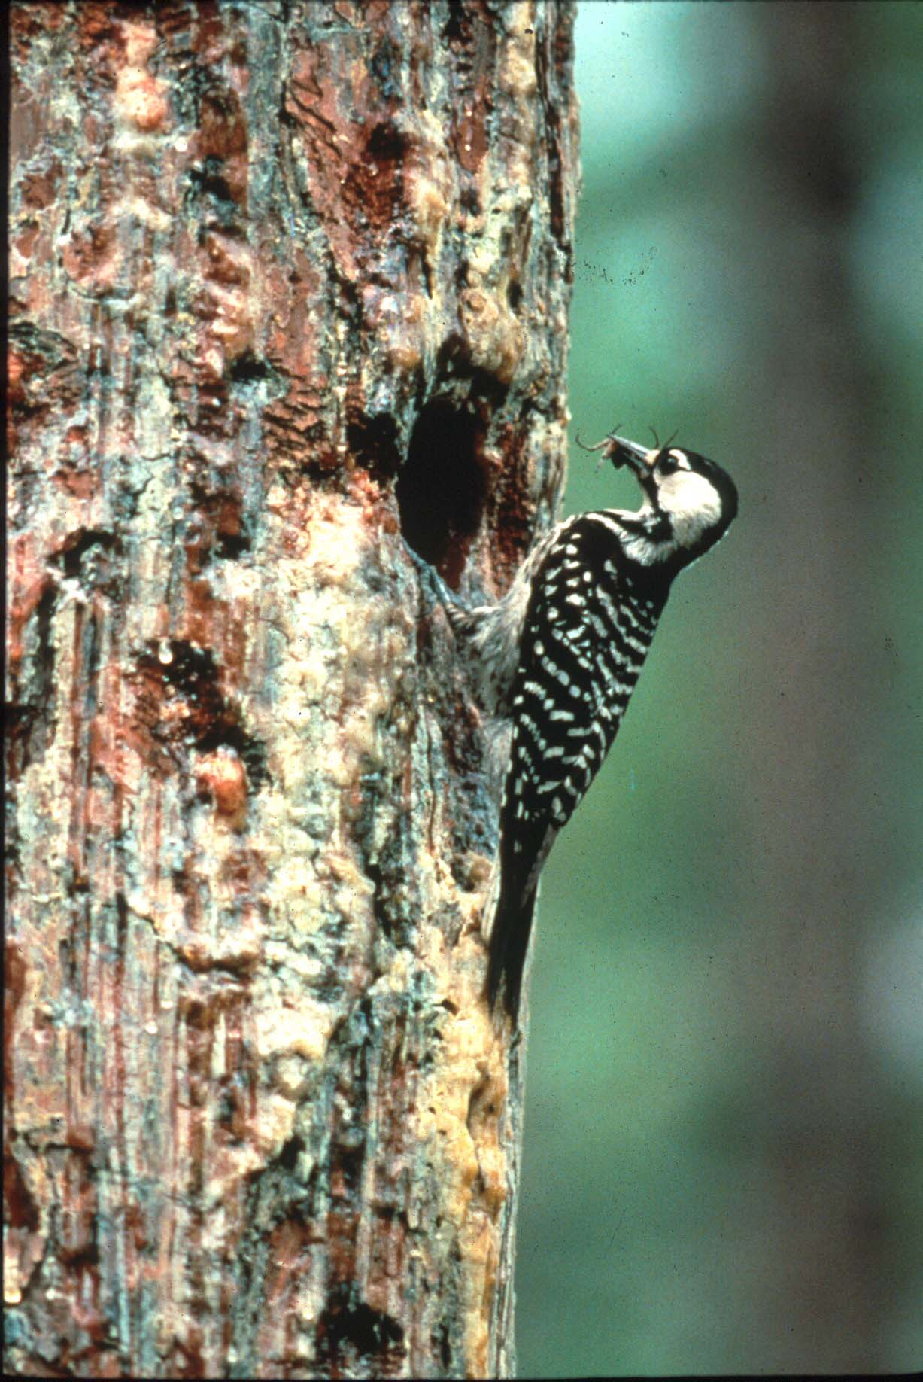
PHOTO

Slide 15
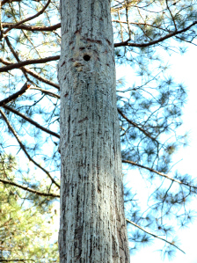
PHOTO

Slide 16
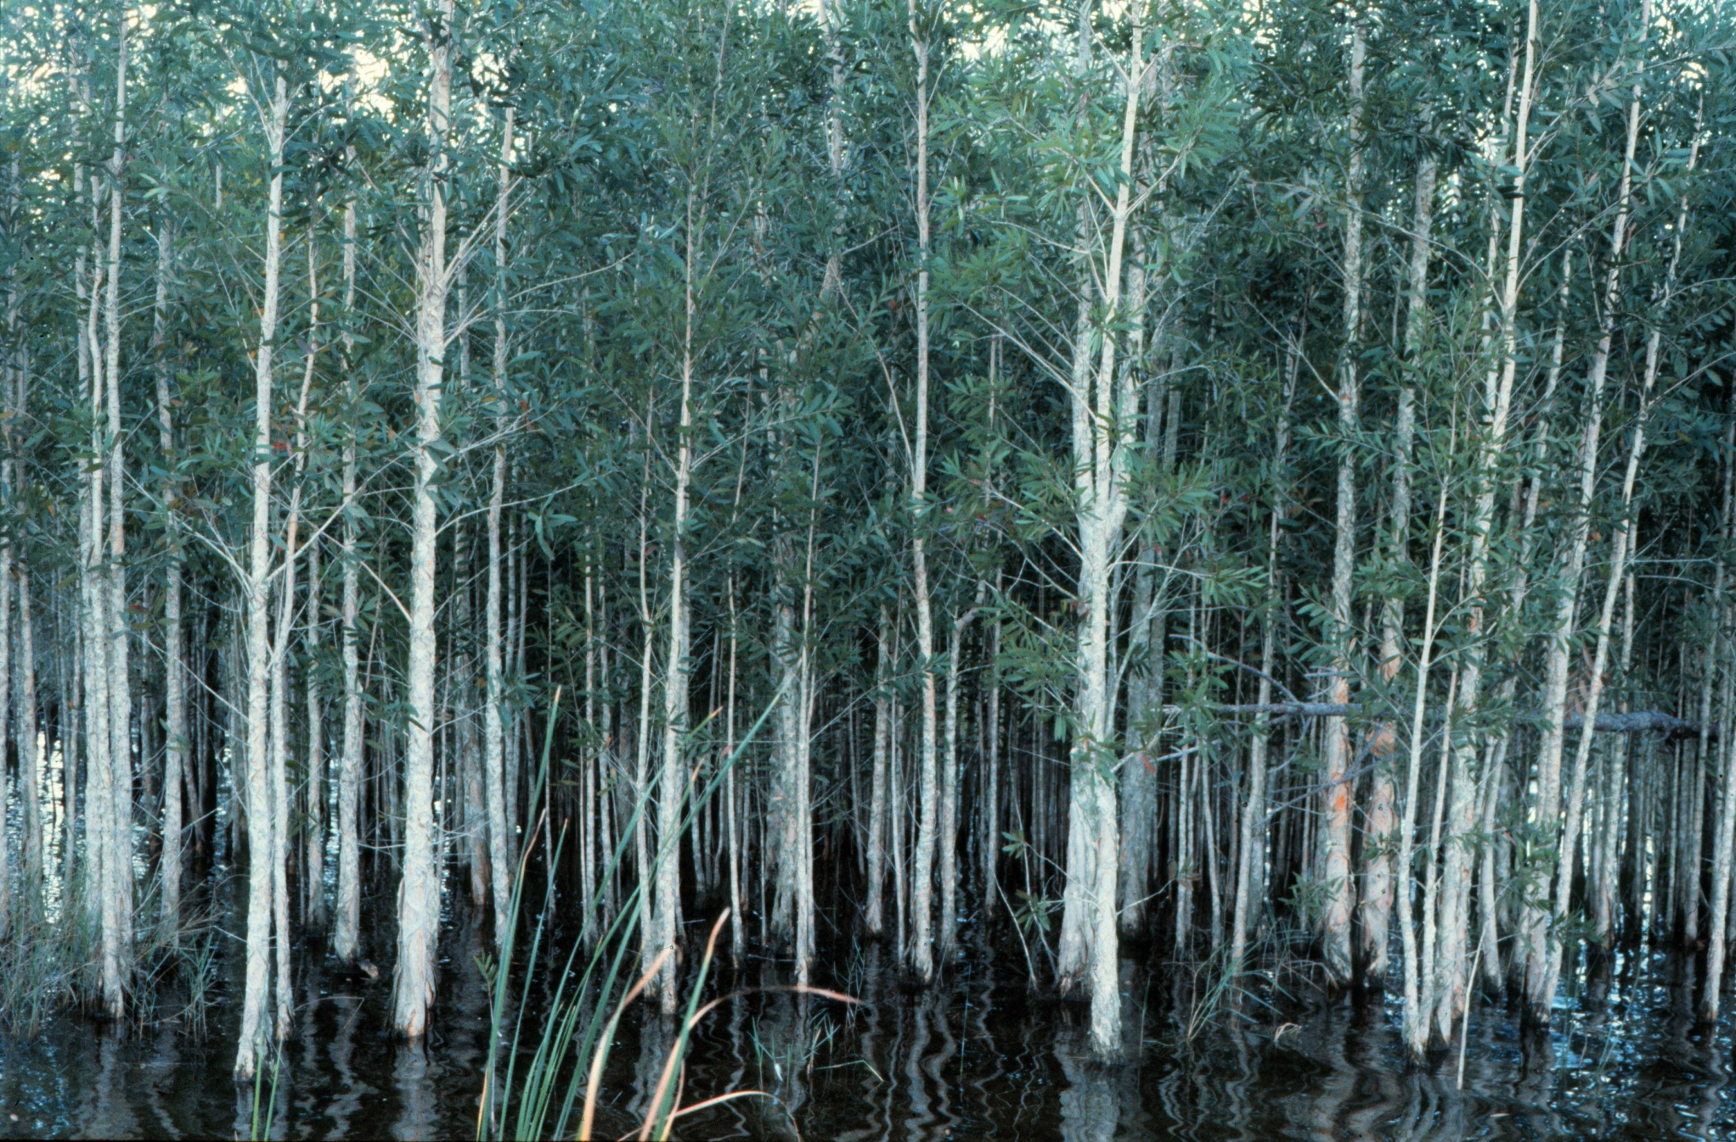
PHOTO

Slide 17
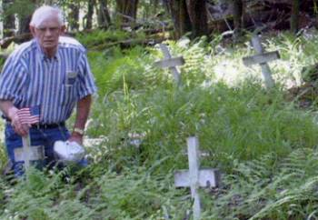
PHOTO

Slide 18
FSH 2509.13
Responsibility of Team Leader
  If the reconnaissance survey shows that emergency rehabilitation is needed and justified, document this conclusion on Form FS-2500-8 (Burned-Area Report), and recommend to the Forest Supervisor that the burned-area survey team be formed .

Slide 19
BAER ASSESSMENT TEAMS
Team Leader
Soil Scientist
Wildland Hydrologist
Plant Specialist
GIS specialist
Wildlife Biologist
Archeologist
Wilderness Resource Advisor
When formulating treatments and alternatives they provide invaluable input
Others depending on complexity
  NEPA, Forester, Operations,

Slide 20
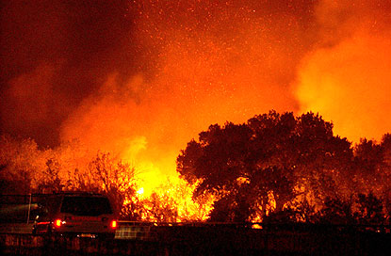
The Process
Complexity Analysis
  Size up Fire
  Burn Intensity Map
  Assess Effects
  Threats
Determine Team
Write Ops Plan
Write ESR Plan
Select Impl Ldr
Implement Specs
Monitor and Assess
Submit Reports

Slide 21
Burn Complexity Analysis
To determine the organization of the Planning Team
Preliminary Field Recon by Air or Ground
  Burn Intensity Map
  Acreage
  Vegetation Types and Resource Values
  Threats to Humans, Developments, Resources
  Land Owners and Jurisdictions

Slide 22
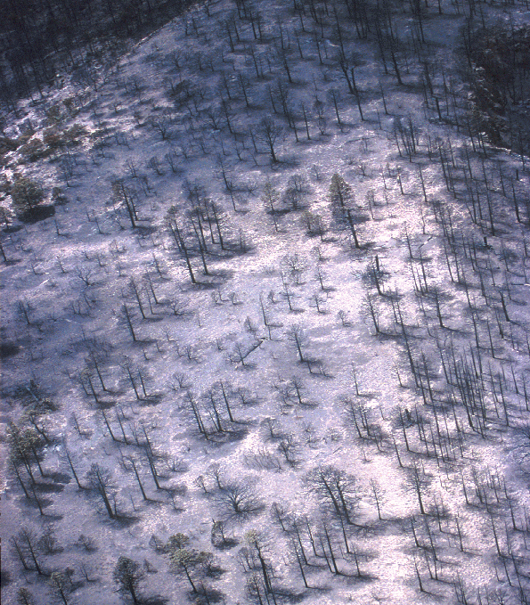
Qualitative Indicators
Fire residence time can be judged by completeness of fuel consumption:
Low = black ashes
Moderate = grey or mixed ashes
High = white or red ashes

Slide 23
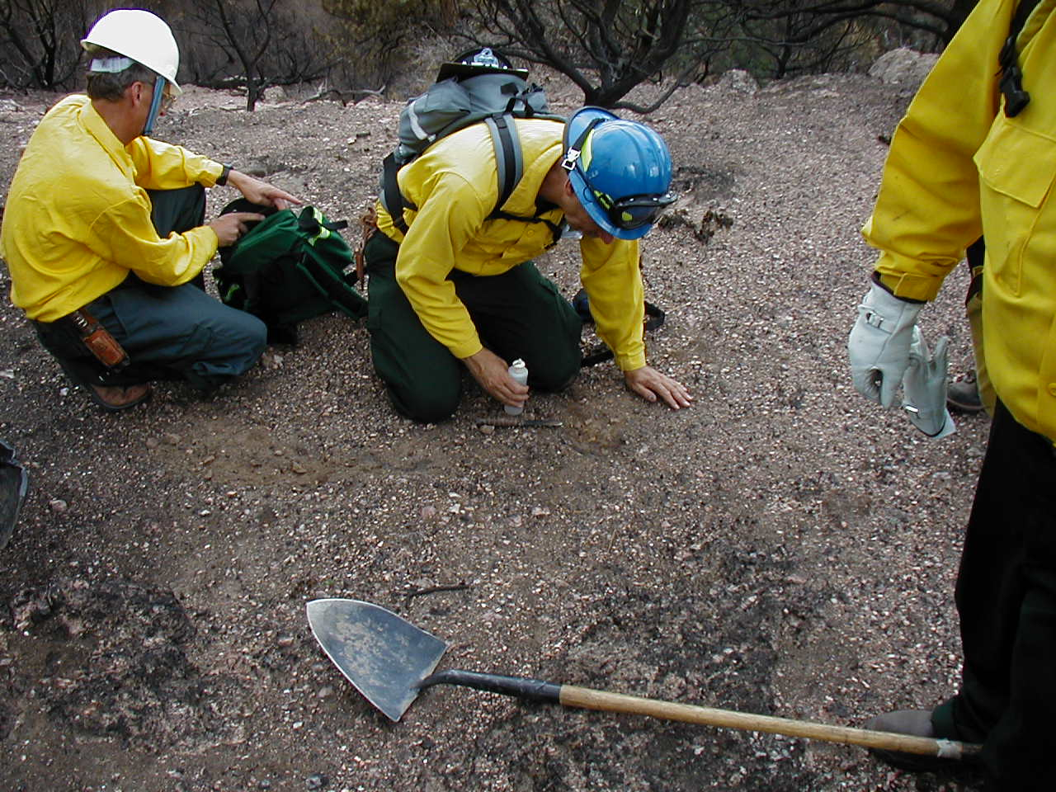
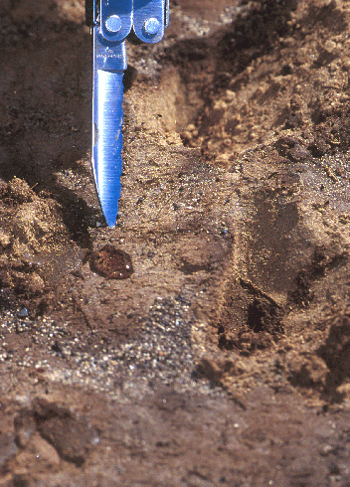
Soil Hydrophobicity
Less than 1 minute = none
1-3 minutes = low
3-10 minutes = moderate
More than 10 minutes = high

Slide 24
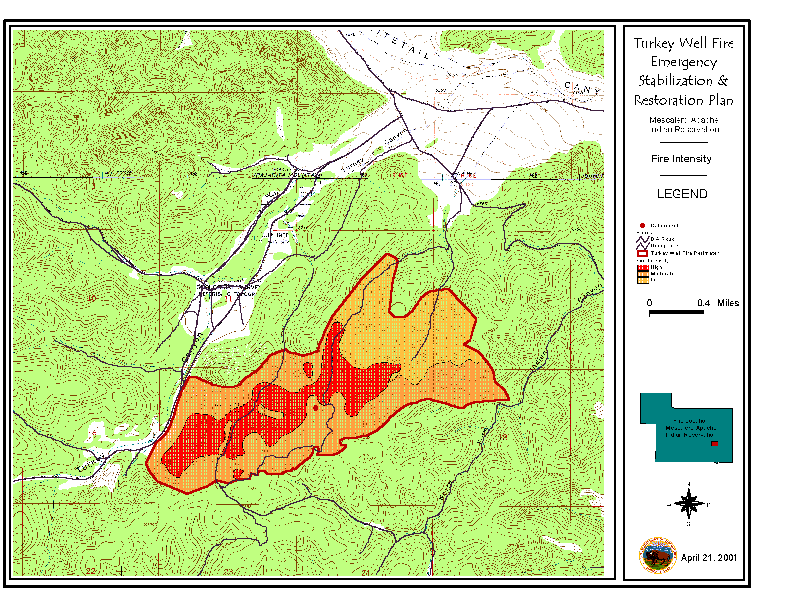
FIRE INTENSITY MAP AND THREATS

Slide 25
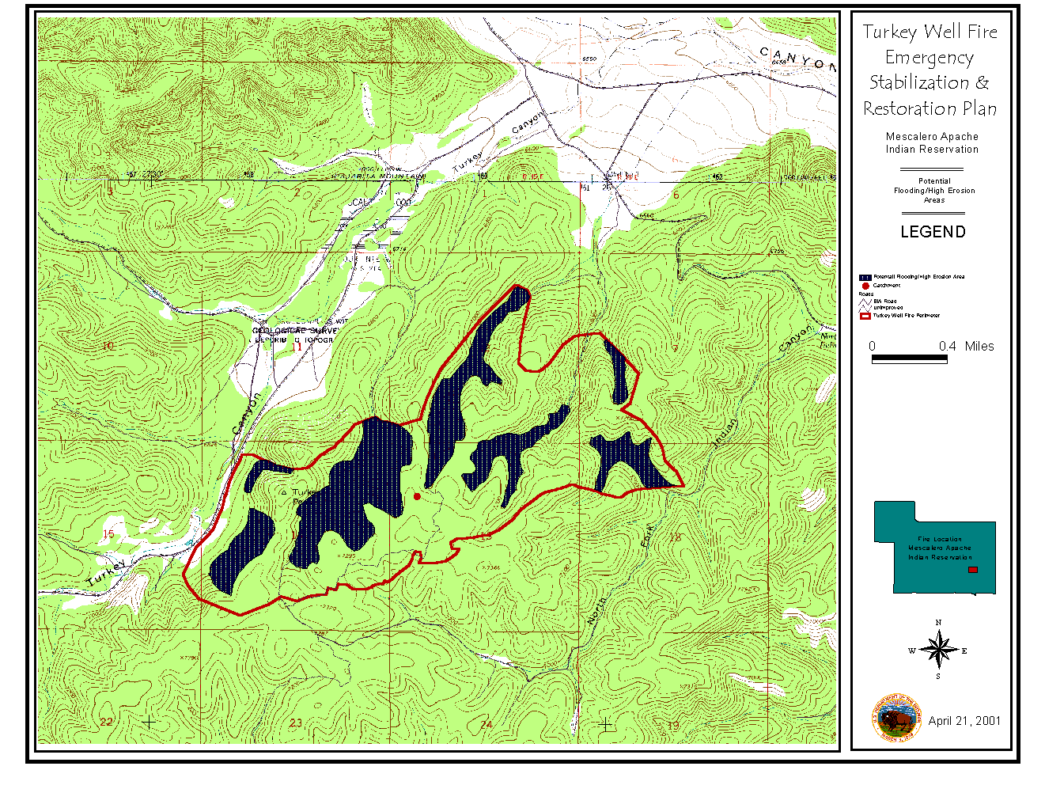
POTENTIAL FLOODING & HIGH EROSION

Slide 26
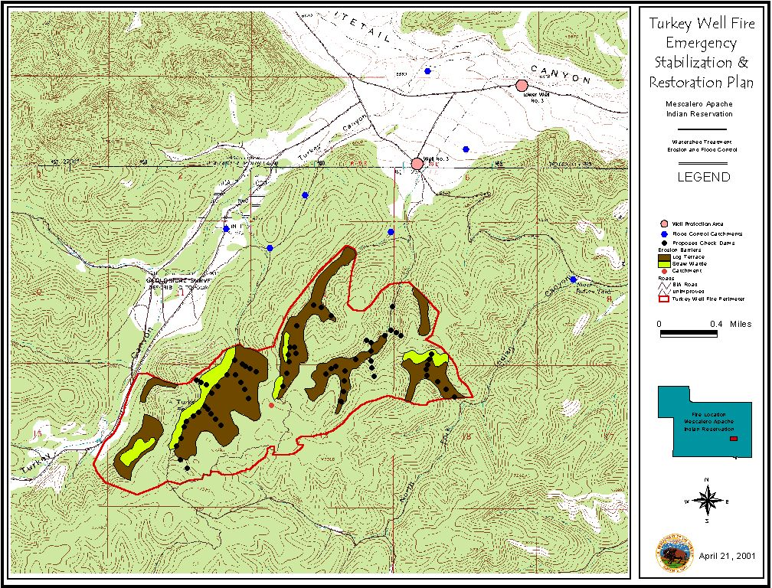
WATERSHED TREATMENTS

Slide 27
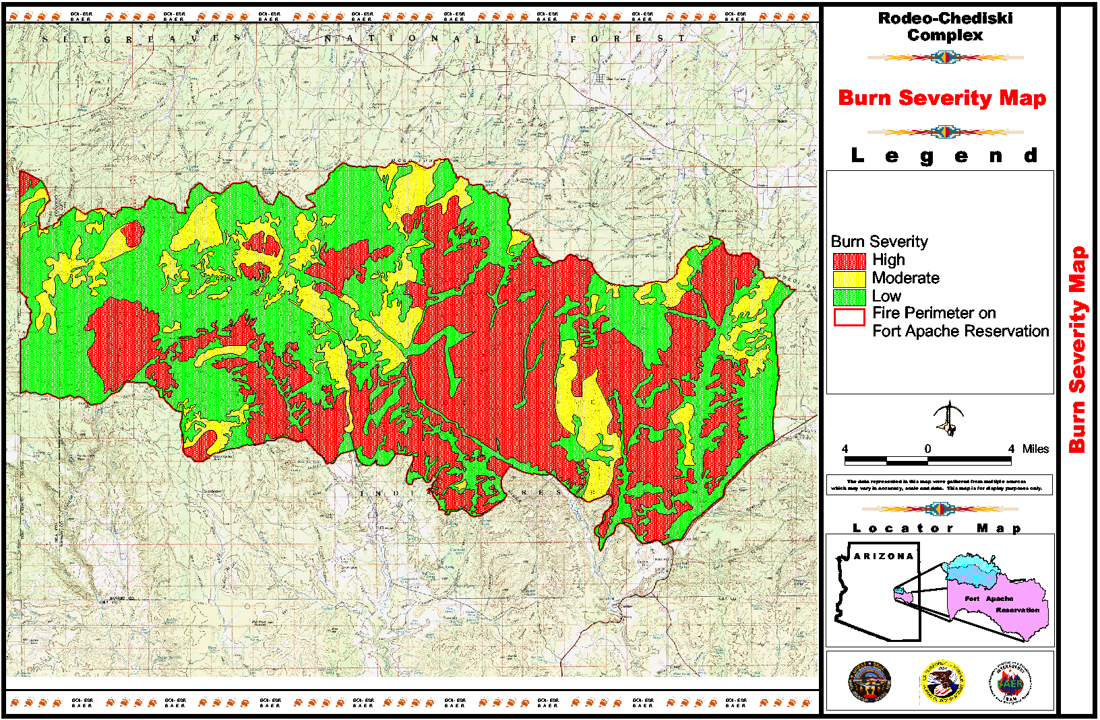
Rodeo-Chediski Fire

Slide 28
BAER TREATMENTS

Slide 29
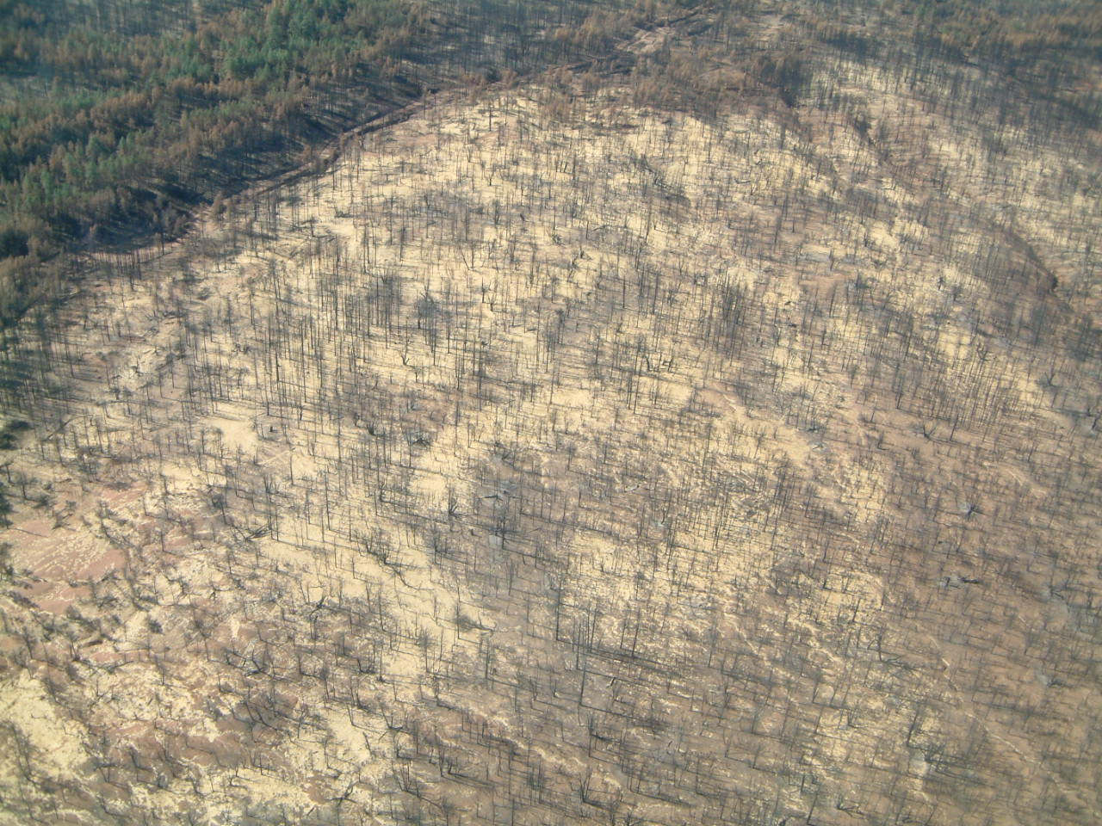
Wilderness BAER Treatments
Minimum necessary to address protection needs
Minimize intrusion of motorized equipment
Minimize introduction of NNIS
Leave area natural
Utilize native materials
Utilize materials or structures that area
temporary and plan for removal

Slide 30
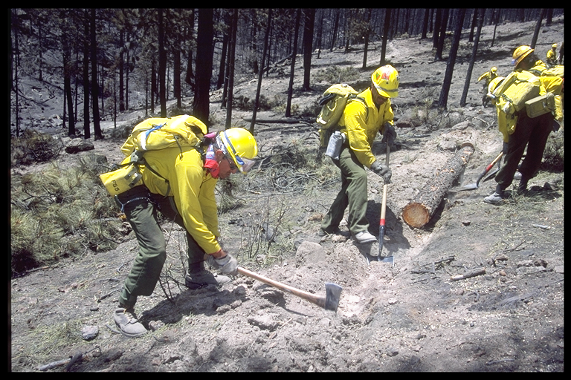
Slope Treatments
Notes:
Log erosion barriers are also very labor intensive and are rarely prescribed on large areas.

Slide 31
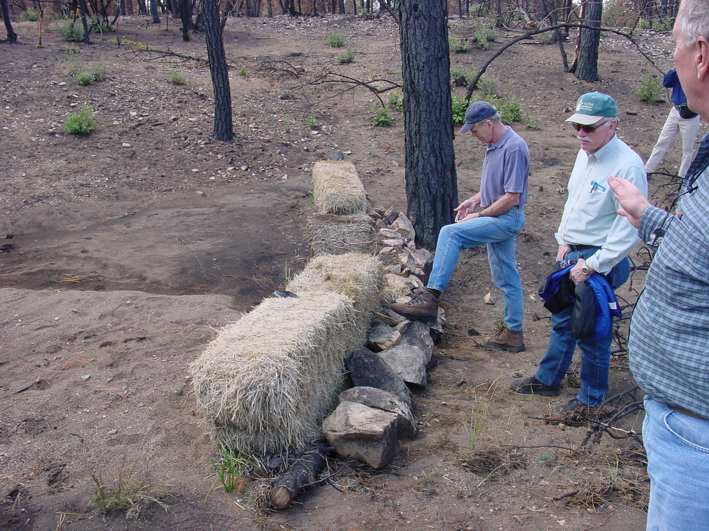
Channel structures
Notes:
Structures may be installed in the top of the watershed to capture sediment.

Slide 32
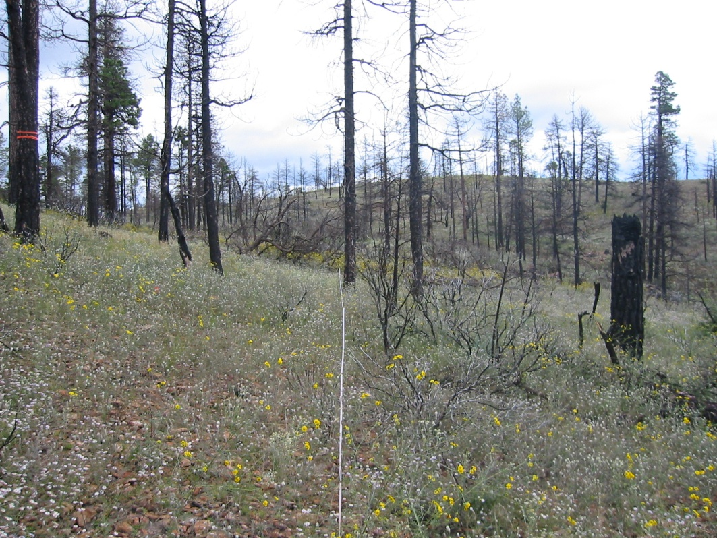
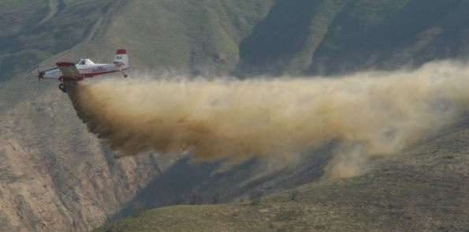
AERIAL SEEDING

Slide 33
Straw Mulching

Slide 34
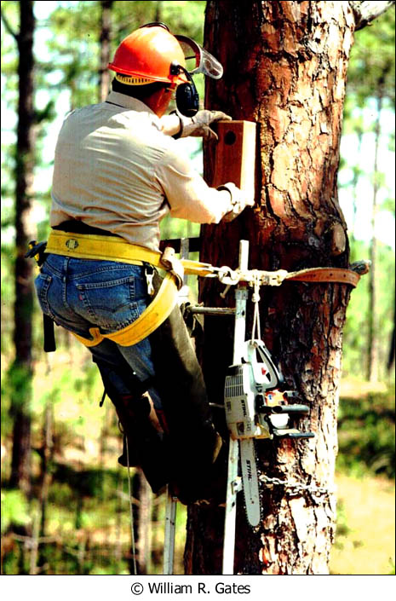
RCW Cavity Inserts

Slide 35
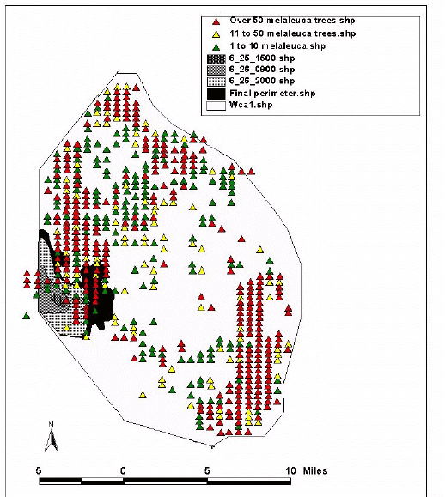
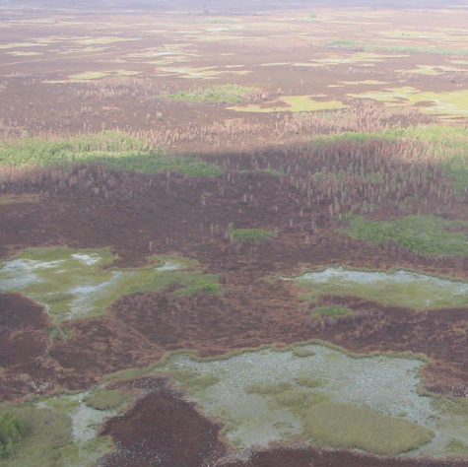
Invasive species treatments, Rehab Plan
Loxahatchee National Wildlife Refuge
Section 3 Fire
June 25-27, 2001
9,000 acres

Slide 36
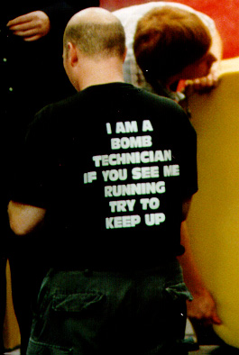
IMPLEMENTATION LEADER
It is critically important that a project implementation leader be assigned to coordinate rehabilitation activities.
The first six months will be particularly complex and time consuming and should not be a collateral duty assignment.
Experience has indicated that the ability of the agency to quickly hire a project implementation leader will effect the overall success of the project.

Slide 37
SUMMARY
BAER Program
BAER Mission:
The BAER program addresses short-term post-fire emergency situations with the goal of protecting life, property, natural, and cultural resources.
Why do we do BAER?
Post-fire hazards can KILL people and DAMAGE property and resource values.
Program Limitations:
BAER is not an opportunity to fix historic problems, expand programs or personnel, or conduct new surveys or long-term restoration.
Notes:
Key notes:

Slide 38
PRE-SEASON PREPAREDNESS
Select and maintain BAER team roster - team leaders, members, support personnel and trainees
Establish pre-planned treatment strategies
Keep current management direction accessible (LMP, Department Manuals, IA BAER Handbook, etc.)
Insure team readiness - safety, personal gear, availability status for on-forest and off-forest assignments, logistics, etc.,

Slide 39
WHERE TO GET MORE INFORMATION
Regional Coordinators
Sue Wilder – USFWS
Emanuel Hudson – USFS
Caroline Noble – NPS

Slide 40
WHERE TO GET MORE INFORMATION
Interagency Burned Area Emergency Stabilization and Rehabilitation Handbook
National Interagency Training Sessions
Field Operations Guide
NIFC Websites
BAER Briefcase CD

Slide 41
DOI Web Site
http://fire.r9.fws.gov/ifcc/Esr/home.htm
USFS Web Site
http://www.fs.fed.us/biology/watershed/burnareas/

